Slide 1
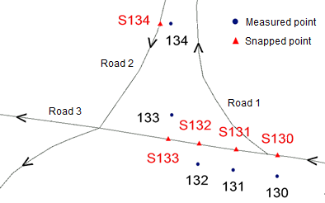
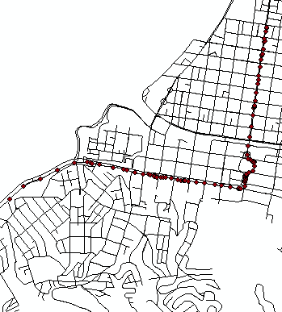
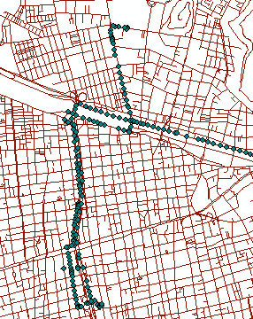
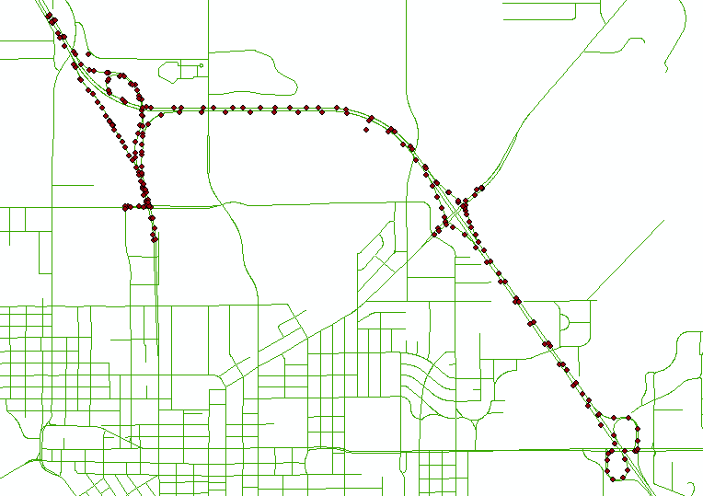
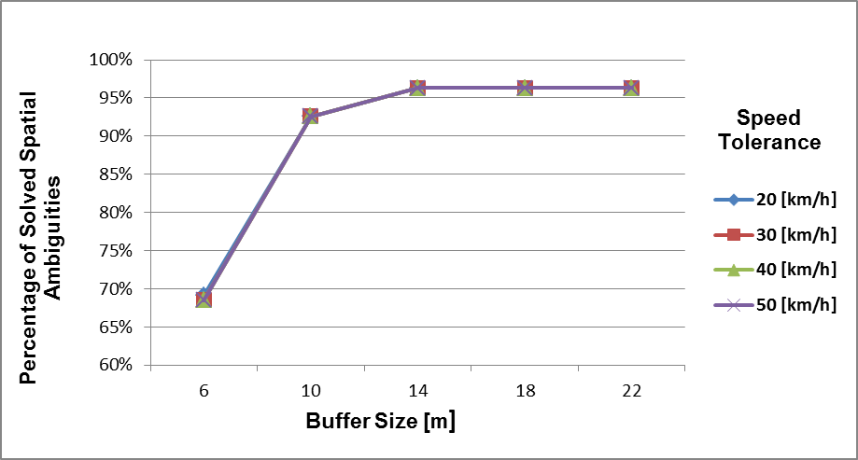
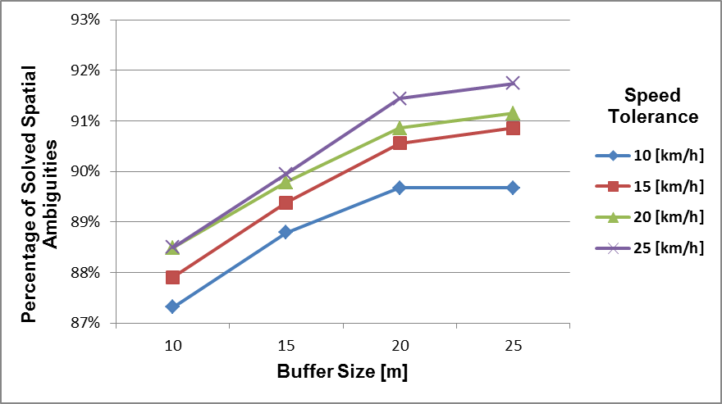
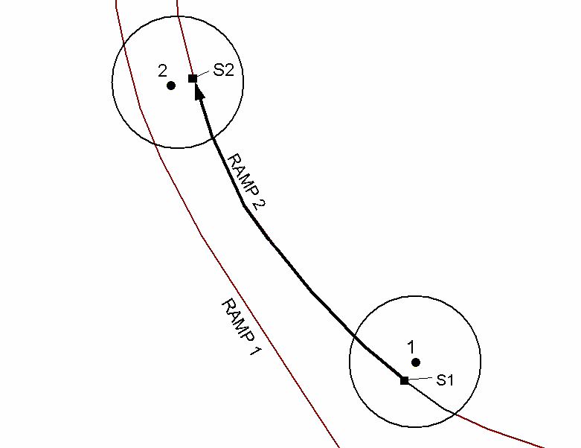

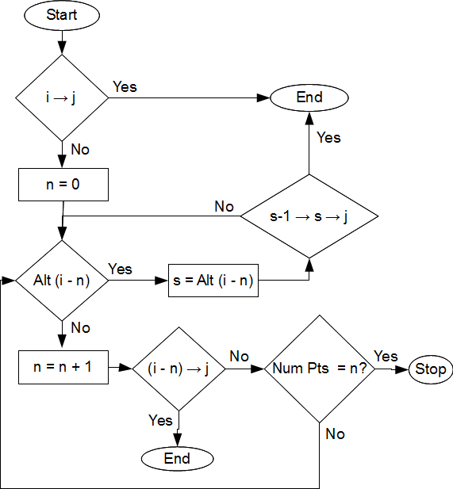
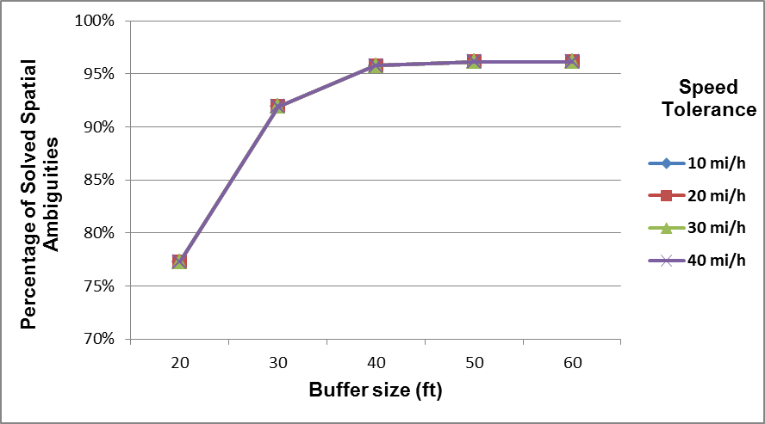
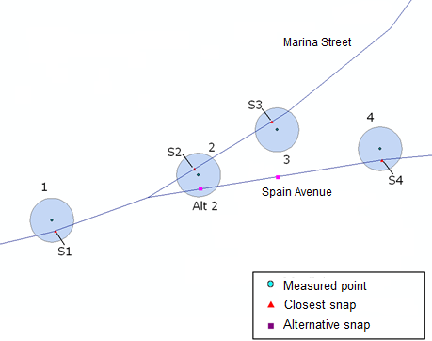
A REAL-TIME METHODOLOGY FOR SOLVING MAP-MATCHING PROBLEMS IN GIS-BASED TRANSPORTATION NETWORKS
Carola Blazquezª, Pablo Miranda^{b} and Jorge Barahona^{b}
ª Department of Engineering Sciences, Universidad Andrés Bello, Chile
^{b} School of Industrial Engineering, Pontificia Universidad Católica de Valparaíso, Chile
ABSTRACT
IMPLEMENTATION ISSUES
Vehicle locations do not exactly register with roadway centerlines due to errors in the GPS measurements and digital roadway maps, particularly in dense urban areas. This phenomenon may lead to a map-matching problem, where a vehicle may appear to be traveling on an incorrect roadway.
This paper proposes a real-time methodology based on a previously developed post-processing map-matching algorithm, in order to rapidly and effectively identify the correct roadway centerline segment on which a vehicle is traveling. The proposed algorithm and different controlling parameter values were tested on three digital roadway maps and data collected every 5 and 10 seconds along highways and local roads in Valparaiso and Santiago, Chile, and Portage County, Wisconsin in the United States.
The results indicate that the proposed methodology performs similarly to the post-processing algorithm. These results depend upon the spatial data quality and the temporal resolution employed. Best algorithmic parameter values are presented for maximizing solved spatial ambiguities, thus enhancing the performance of the real-time map-matching algorithm.
Feasibility examination between pair of points
Example of an unsolved spatial mismatch.
COMPUTATIONAL APPLICATION
Spatial Datasets
Algorithmic Parameters
INTRODUCTION
Valparaiso, Chile
Scale: 1,500
Santiago, Chile
Scale: 1,500
Portage County, Wisconsin, USA
Scale: 1:24,000
Map-matching problems or spatial ambiguities occur when GPS data points snap to incorrect roadway centerlines due to lack of accuracy in the digital cartography, the GPS measurements, or both, particularly at diverging/converging roads or intersections.
Analysis Results
Comparison Analysis: Post-Processing versus
Real-Time Methodologies
Road 1
Correct
Snap
Incorrect
Snap
Road 2
Measured
DGPS
REAL-TIME MAP-MATCHING ALGORITHM
Route 1 in Valparaiso, Chile
Example of snapping process to the correct roadway for two GPS data points.
v₂, t₂
Data points 1 and 2 are snapped to the closest roadway (i.e., Ramp 2) contained within the buffers around the data points. Subsequently, a shortest path is computed, and recorded and computed speeds are compared to determine correct snapping locations.
D
v₁, t₁
Route 3 in Santiago, Chile
Flow diagram of the real-time map-matching algorithm.
Percentages of solved spatial ambiguities are greater for the post-processing methodology since the complete data set is known in advance.
Similar best parameter values are needed for both methodologies, in order to maximize the percentage of solved spatial mismatches.
Route 6 in Portage County, Wisconsin, USA
CONCLUSIONS
The proposed real-time methodology rapidly and efficiently identifies correct vehicle routes using a map-matching algorithm by employing only historical data.
The performance of the real-time methodology is sensitive to variations in the buffer size. Larger buffer sizes and speed ranges are required to obtain best results.
On average, the results of the real-time methodology are 3% less than the post-processing map-matching algorithm.
Future research includes the assessment of the methodology with different spatial data qualities.
Example of a spatial ambiguity resolution at a diverging road
Feasible paths are found between pair of snapped points S1 and Alt2, and between Alt2 and S4. Intermediate point S3 is forced to snap along the path between points Alt2 and S4.
ACKNOWLEDGEMENTS
This research has been supported by the Chilean National Fund for Scientific and Technological Development (FONDECYT 1070386).

